Slide 1

TechRiot – Prototype Demo
Unified Automation Framework -Web and Mobile
Paarrivanan, Lavanya,
Bala, Sravani
17/1/2022

Slide 2
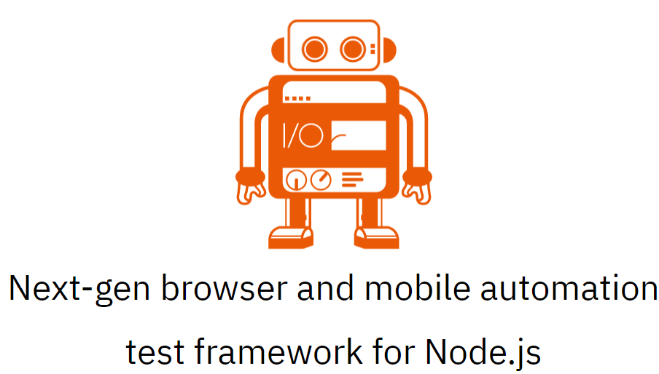

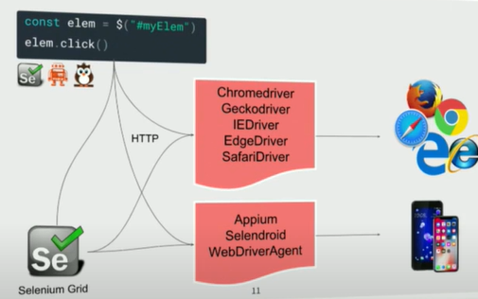

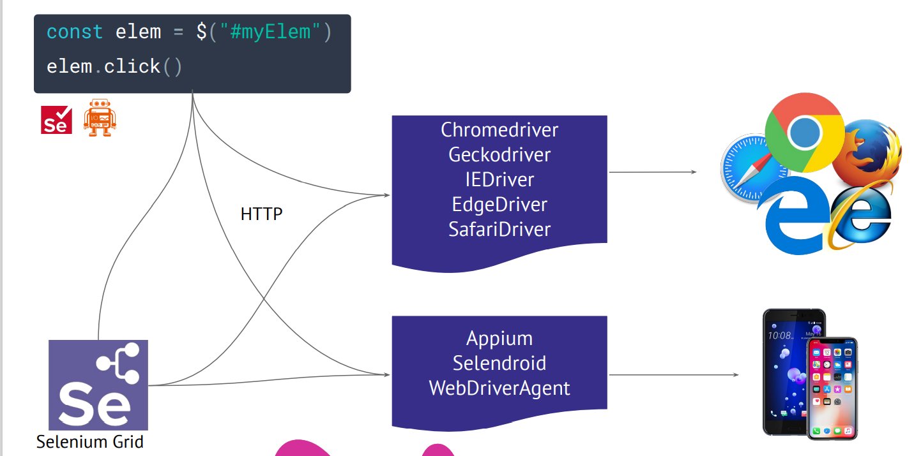
Unified Automation Framework - Solution Proposed
WebdriverIo
JavaScript
Selenium Standalone
Server
Web Browsers
JSON Wire Protocol
Appium Server
IOS/Android Native/Hybrid
Tech Stack Web | Tech Stack Mobile
Tools: Cucumber BDD, JS, Node.js, Allure Reports, VS Code | Tools: Mocha, TS, Node.Js, Android Studio, Appium server, Appium doctor, Allure Reports, VS Code, Junit reports

Slide 3

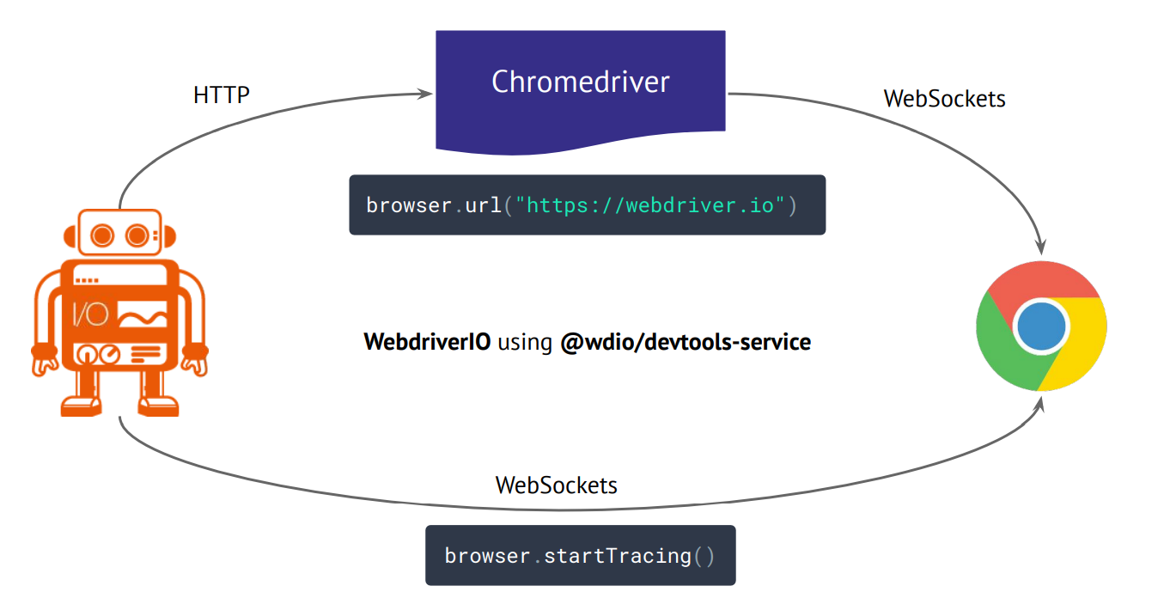
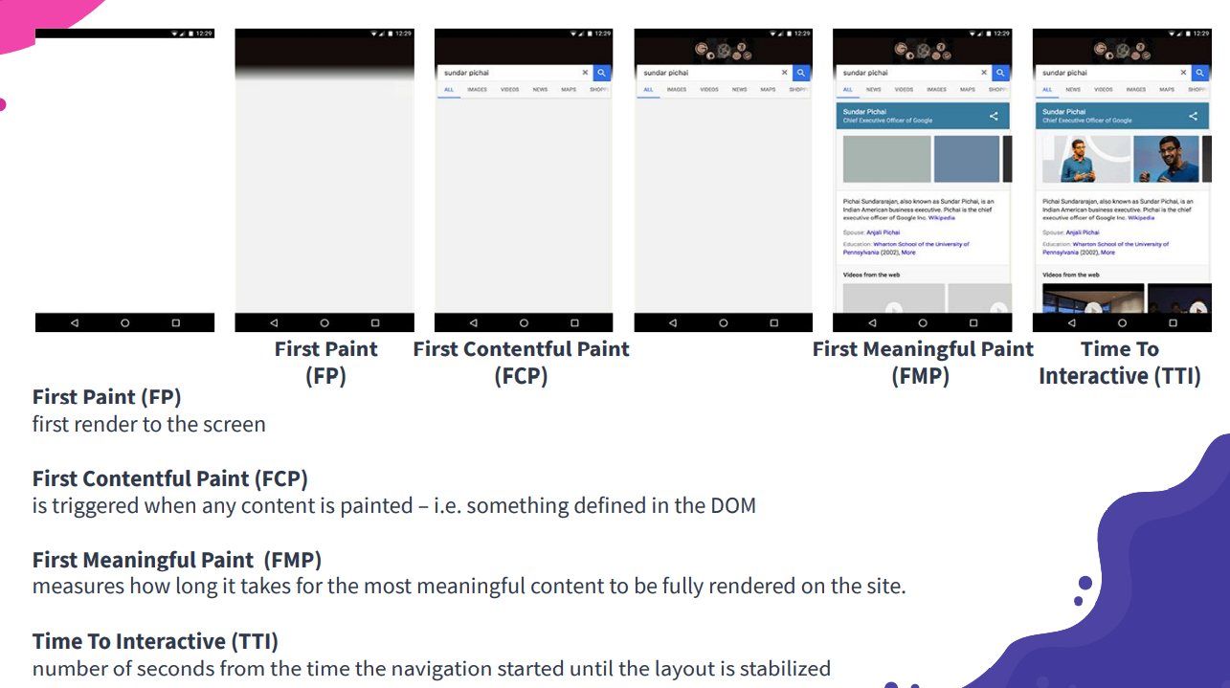
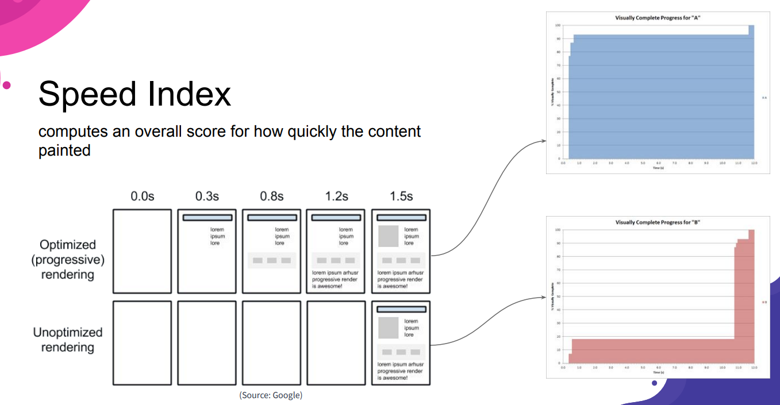
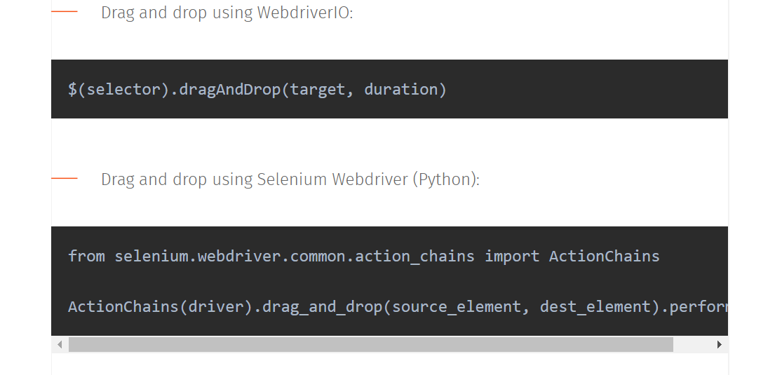
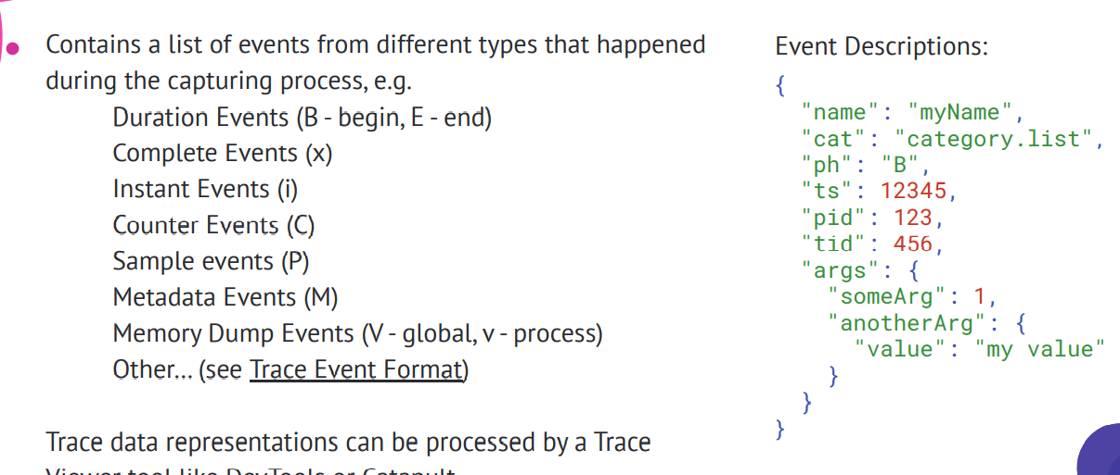
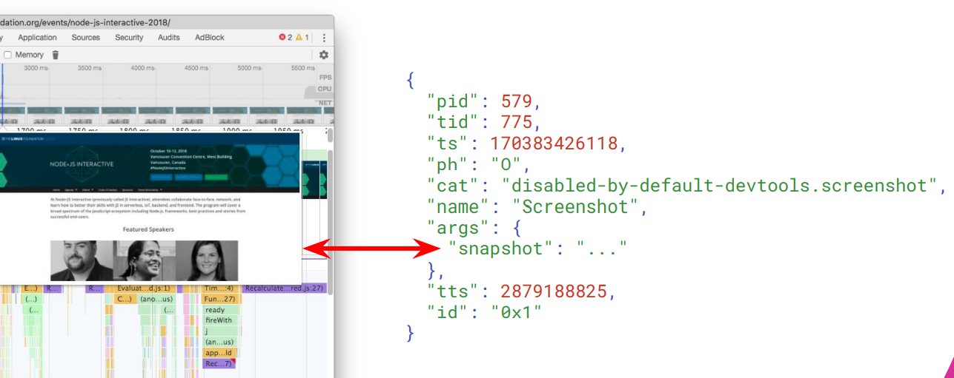
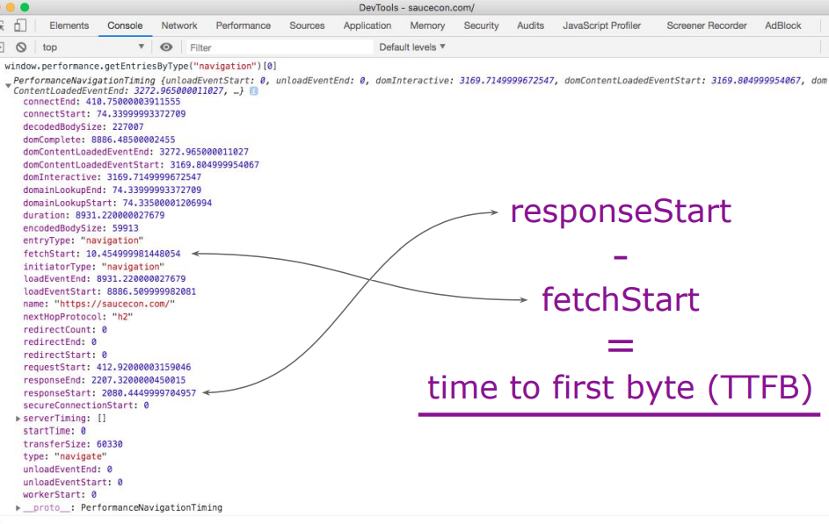
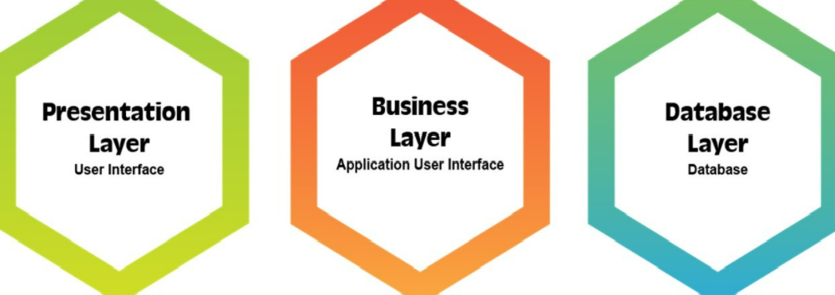
Webdriver.io Capabilities
#Recommended by W3C
#Open Source
#Parallel Testing
#Cross Browser Testing
#Easy Reports Integration
#Modern Web Frameworks
#Multiremote
#API Testing
#Easy Setup & Installation
#Smart Selectors
#Programming skills need minimized
#Jira/Xray Integration at ease
#Framework setup at ease
#Inhouse Unified JS Framework
#Desktop Automation
#Cloud Services
#Dockerization

Slide 4
Thank You
Team: Paarrivanan, Lavanya, Bala, Sravani
References:
Official Doc
WebdriverIO · Next-gen browser and mobile automation test framework for Node.js |

